Slide 1
Daniel Bravo
Christine Trujillo
Briana Hernandez
Youth Soccer

Slide 2
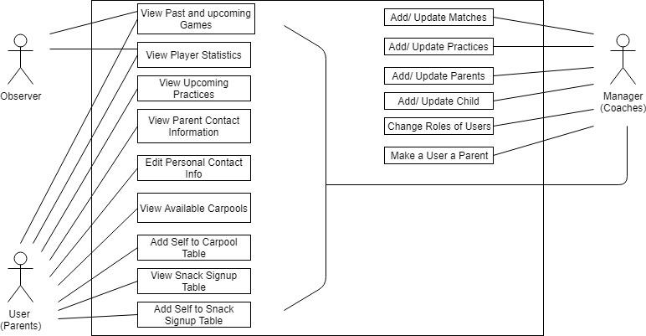
Use Case View

Slide 3
Use Case View - Questions
Questions
What are the stats for past games?
What is the game schedule?
How is my child doing in the games?
What is the practice schedule?
How can I contact other parents?
My child needs to carpool to the next game.
Is anyone bringing snacks to the next game?

Slide 4
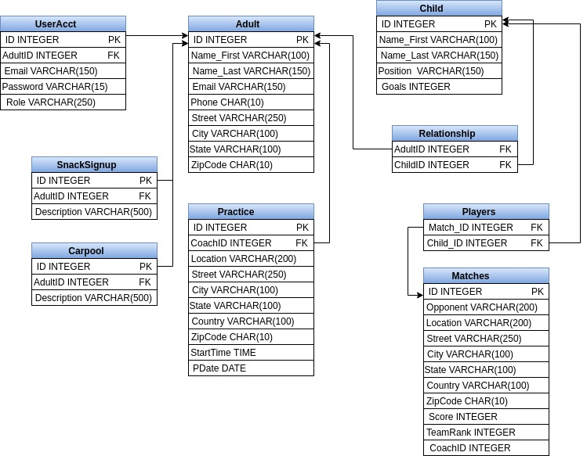
ERD View

Slide 5
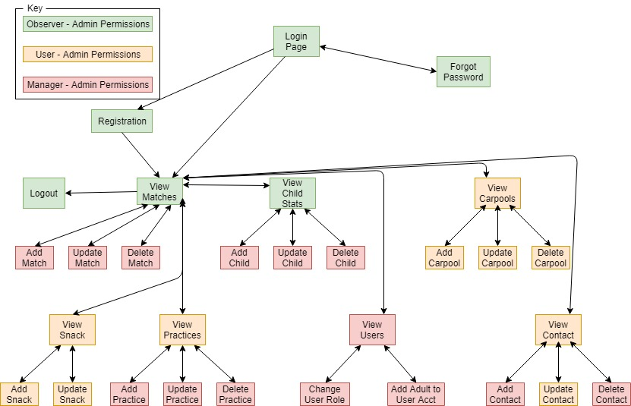
Requirements View

Slide 6
View Games
The system shall display all games in the matches table
The system shall test if a the account is a manager account
The system shall allow managers to add and update games in the matches table
View Player Statistics
The system shall display all player statistics in the child table
The system shall test if a the account is a manager account
The system shall allow managers to add and update games in the matches table
View Practices
The system shall display all practices in the practice table to accounts with user permission or greater
The system shall test if a the account is a manager account
The system shall allow managers to add and update practices in the practice table
View Parent Contact Information
The system shall test if a the account is a user account
The system shall display all contact information in the adult table to accounts with user permission or greater
The system shall test if a the user is a manager
The system shall allow managers to add and update practices in the practice table
View Carpools
The system shall test if a the account is a user account
The system shall display all carpool information in the carpool table to accounts with user permission or greater
The system shall allow user - admin to add and update carpools in the carpool table
View Snack Sign Ups
The system shall test if a the account is a user account
The system shall display all snack sign up information in the snack table to accounts with user permission or greater
The system shall allow user - admin to add and update snacks in the snack table
Update User Table
The system shall test if a the account is a manager account
The system shall display all all users along with associated adult and roles to accounts with manager permission or greater
The system shall allow managers and admin to change roles and add an adult id to the account
Requirements View

Slide 7








Configuration Management View

Slide 8
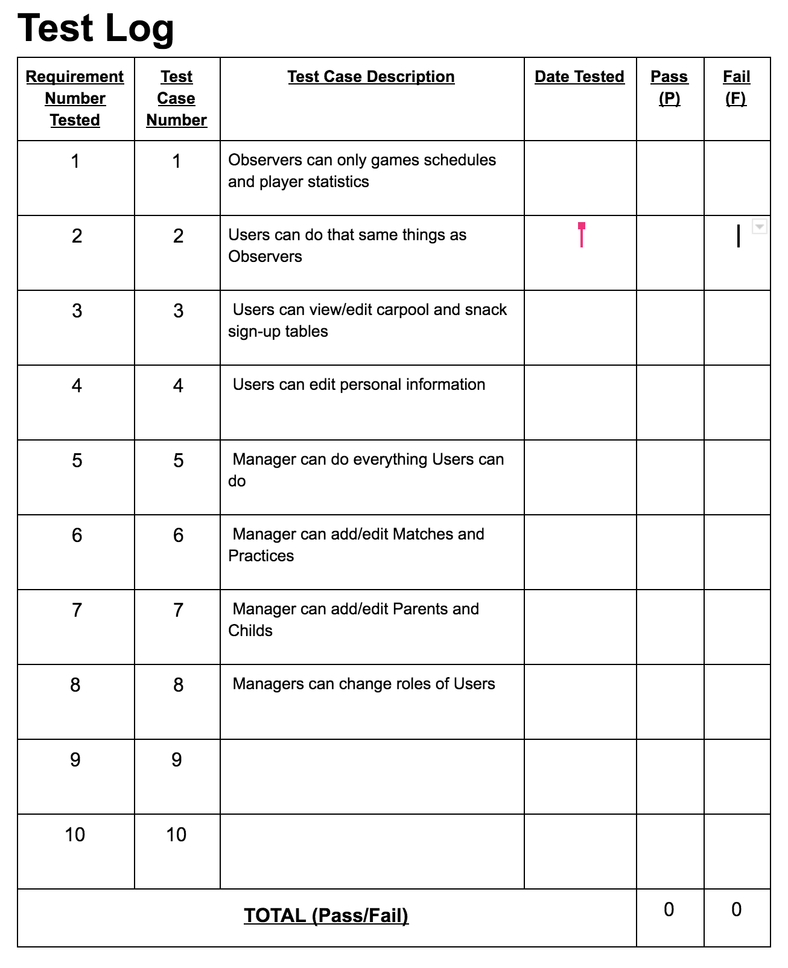
Testing View

Slide 9
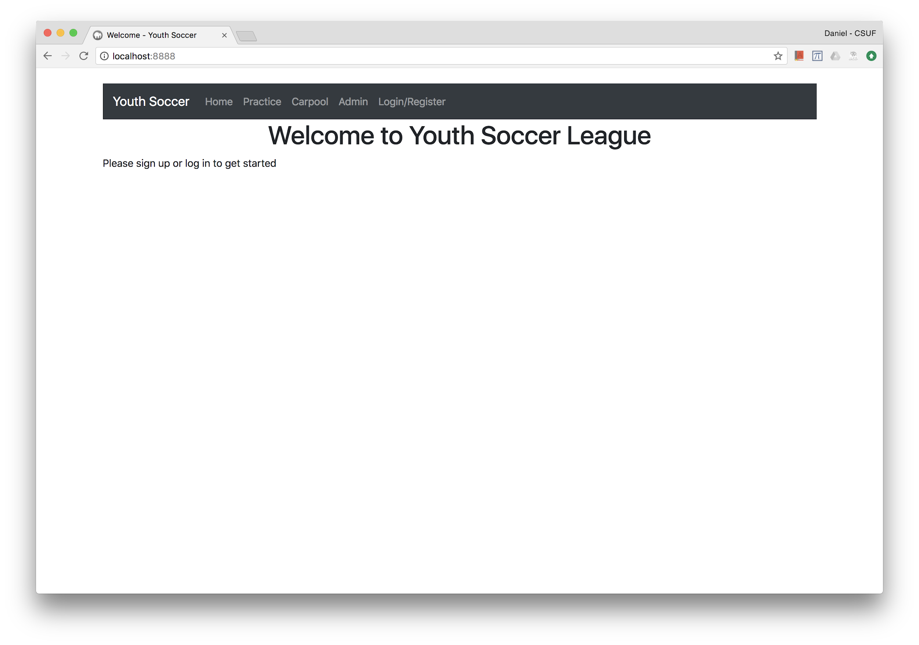
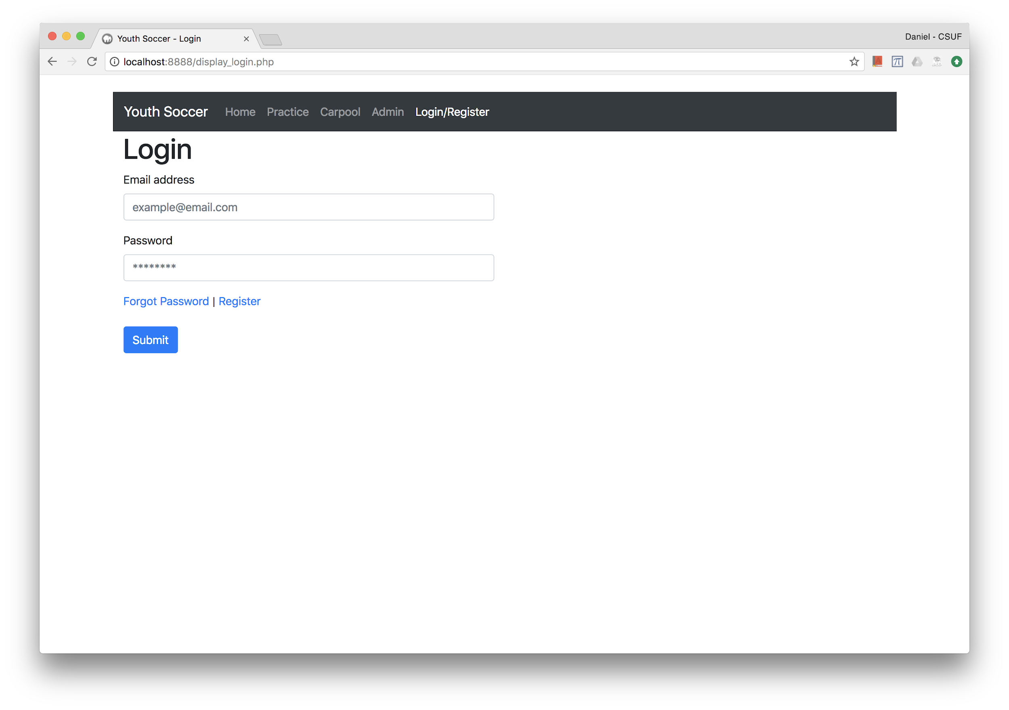
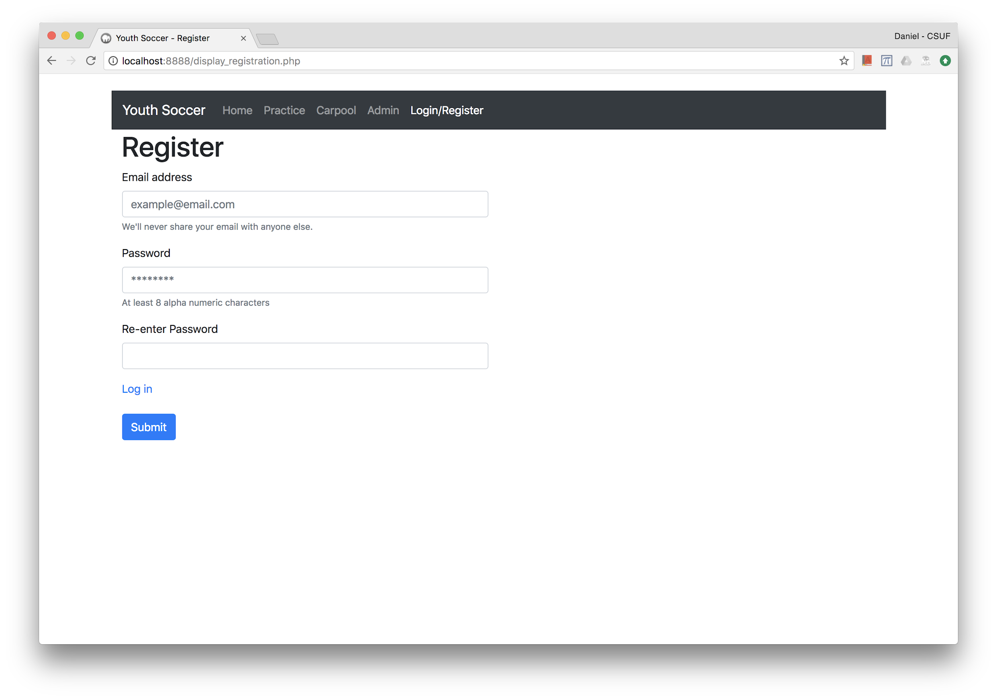

Slide 10
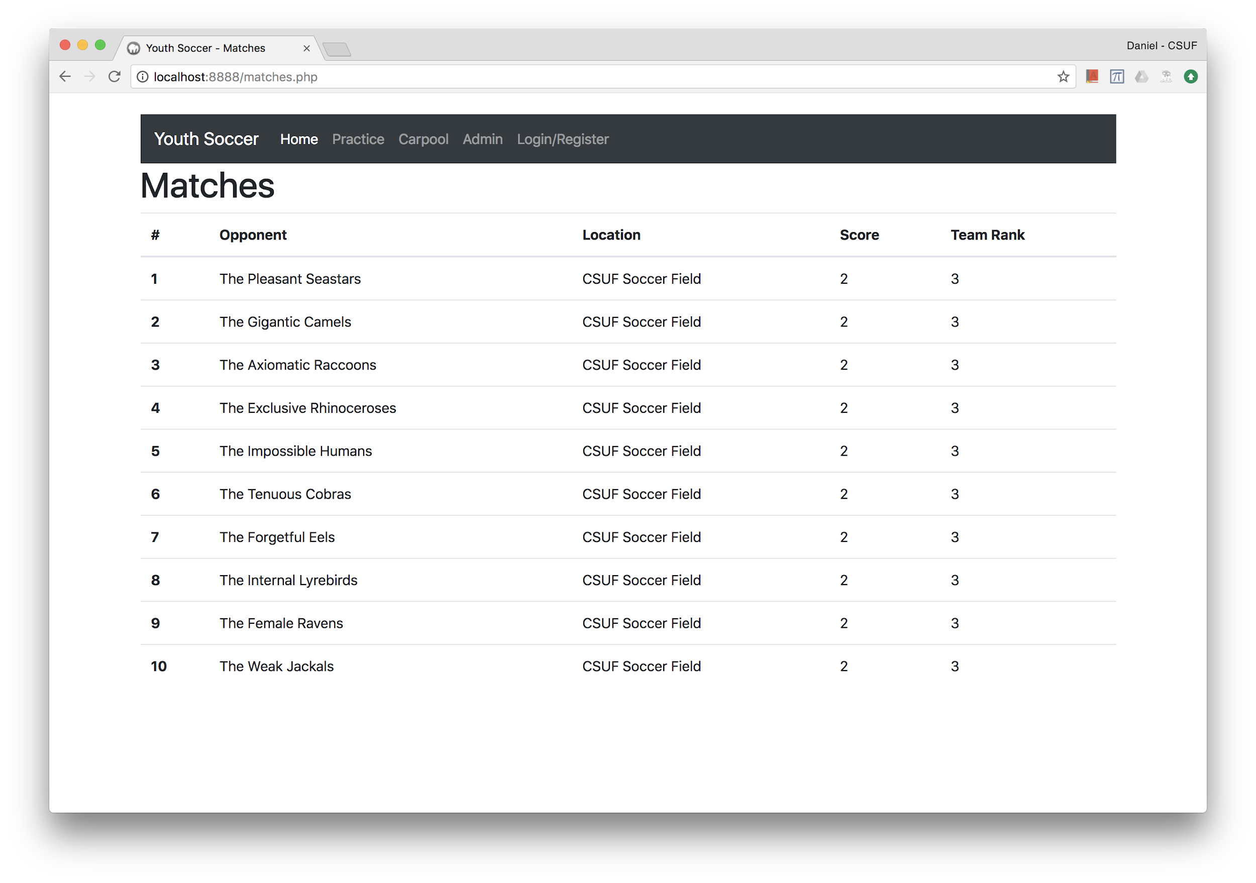

Slide 11
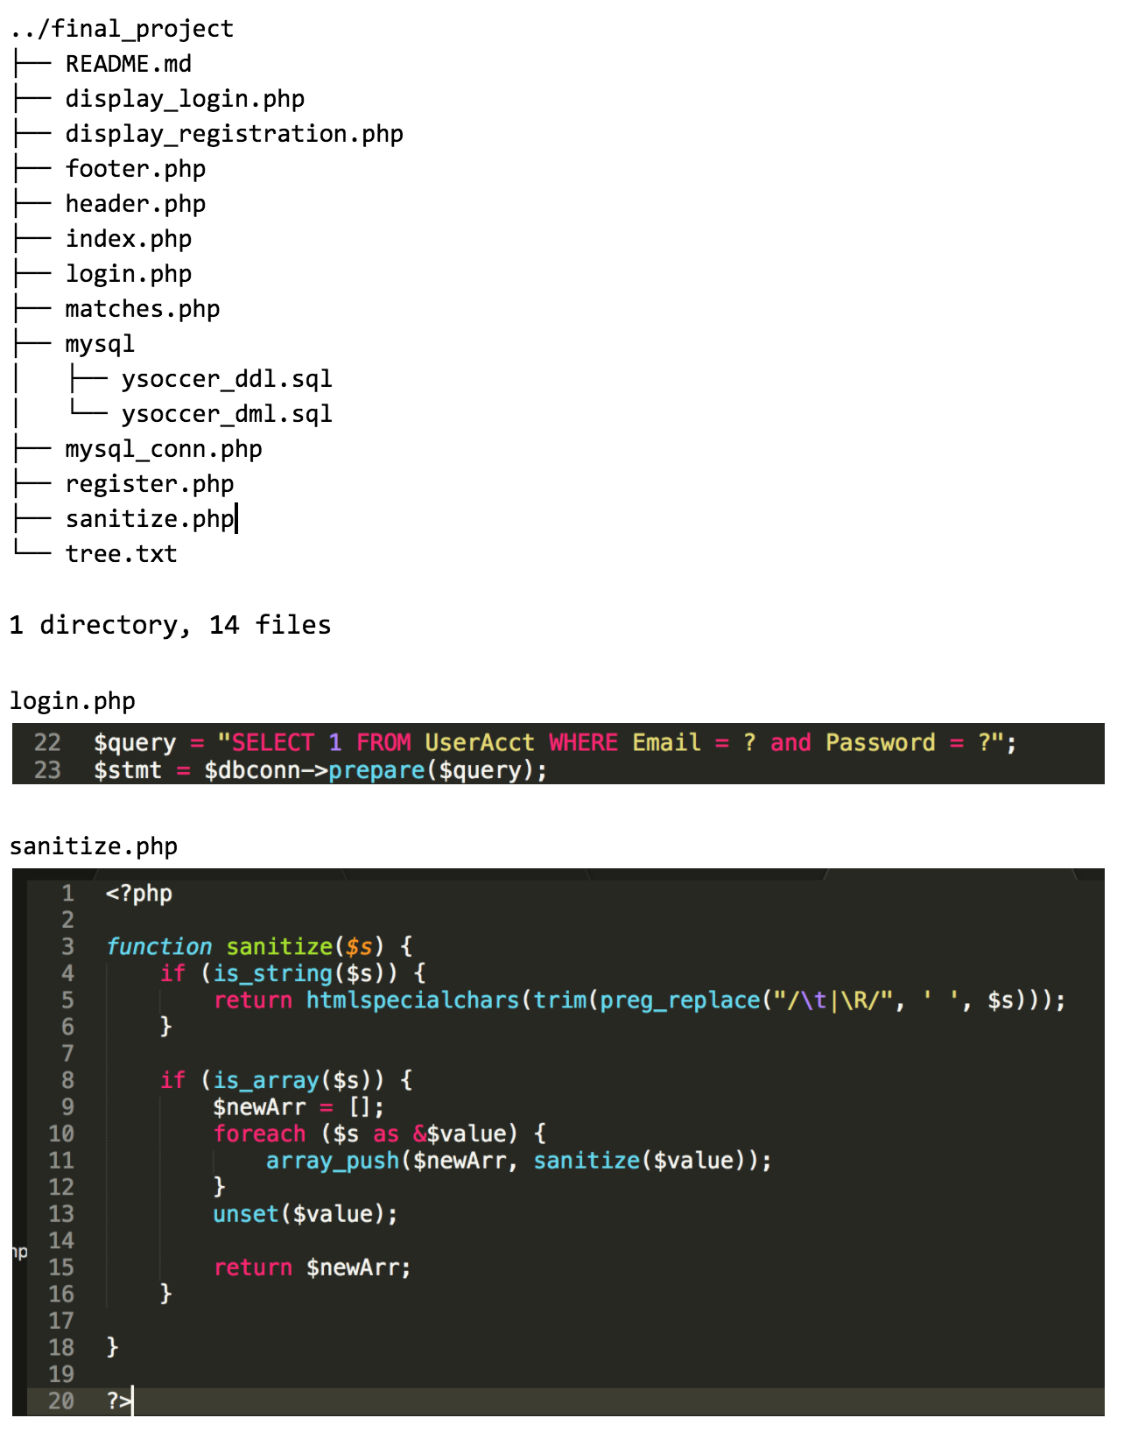
Programing Languages:
PHP
MySQL
Implementation View

